Slide 1

Opportunities to observe or experience some teaching
George Kinnear
G.Kinnear@ed.ac.uk

Slide 2
Mathematical Education
Year 4 course, 20 credits
About 4 hours of teaching in local primary schools (in groups)
Apply for a place during Year 3 (as part of Y4 project selection)

Slide 3
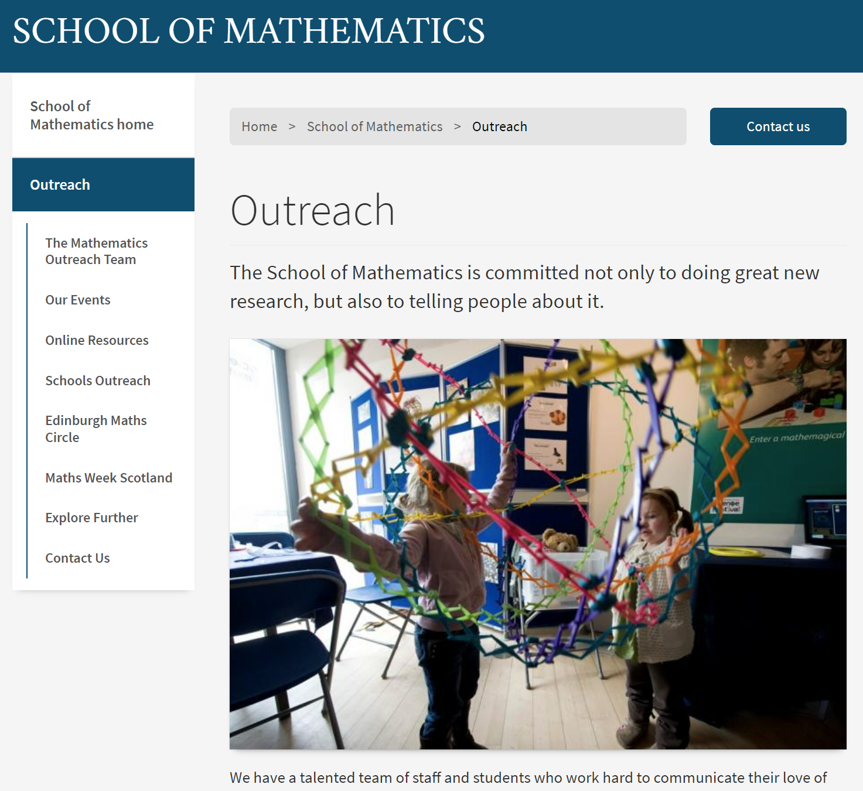
Mathematics Outreach Team
Help to deliver various maths outreach activities:
  Masterclasses
  Science Festival exhibition
  Maths Circles
  School visits
  … !
https://www.maths.ed.ac.uk/school-of-mathematics/outreach

Slide 4

Widening Participation
Various schemes working with local schools (primary and secondary)
Mix of paid and volunteering opportunities
https://www.ed.ac.uk/student-recruitment/widening-participation/projects/current-students-university-of-edinburgh/opportunities-for-current-students

Slide 5
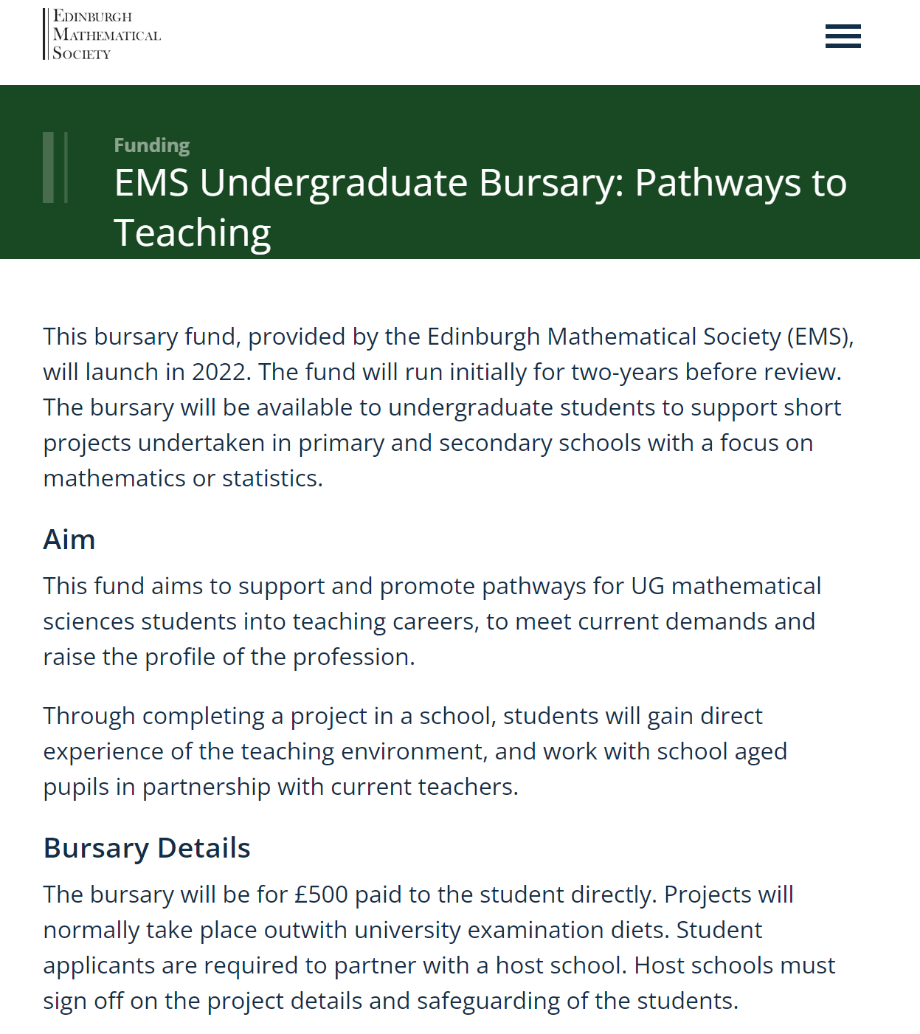
Arrange for yourself!
Visit your old school?
Or find a local school:
  make connections through WP Team
  speak to us!
Bursaries may be available to help, e.g. EMS Pathways to Teaching

