Slide 1
Mathematics Dissertations
Understanding the marking scheme & your audience
English Language Education

Slide 2
Understanding expectations for your project: unpacking the criteria.
Understanding your audience.

Slide 3
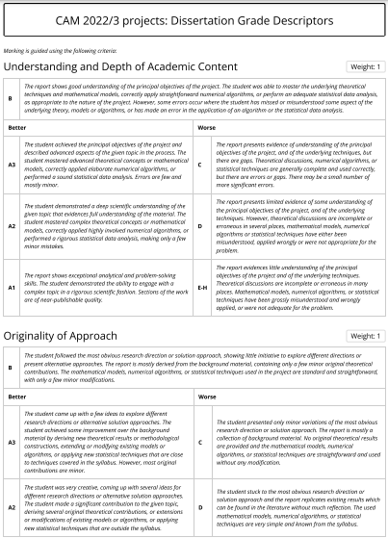
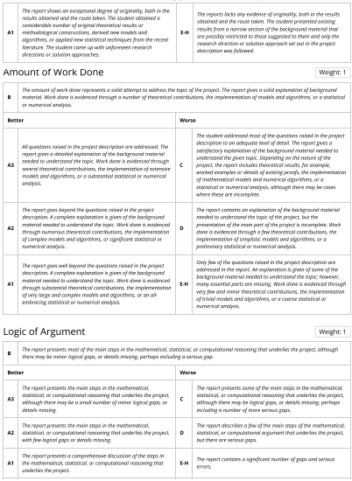
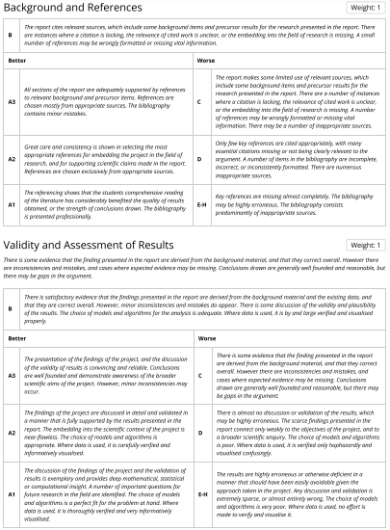
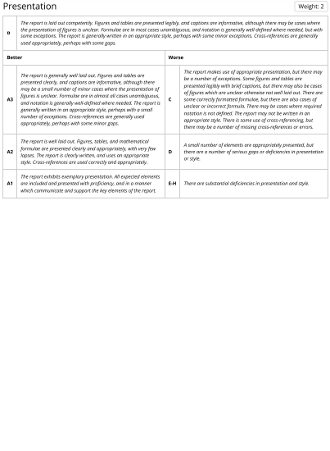
The marking scheme
Descriptor templates MSc Dissertations: Dissertation Grade Descriptors

Slide 4
The marking scheme: Pause and think
Download the marking scheme.
How many criteria are being graded?
Which is the most important criterion?

Slide 5
The marking scheme: Pause and think
How many criteria are being graded?
Understanding and Depth of Academic Content
Originality of Approach
Amount of Work Done
Logic of Argument
Background and References
Validity and Assessment of Results
Presentation
Which is the most important criterion?
They are all important as each criteria feeds into your final grade.
However, criterion 7 (Presentation) carries a double weighting compared to criteria 1-6.

Slide 6
Key language points: Pause and think
Look at the marking scheme again:​
​
Which criteria refer to academic language and style?

Slide 7
The marking scheme: Pause and think
Which criteria relate to academic language?
Understanding and Depth of Academic Content
Originality of Approach
Amount of Work Done
Logic of Argument
Background and References
Validity and Assessment of Results
Presentation

Slide 8
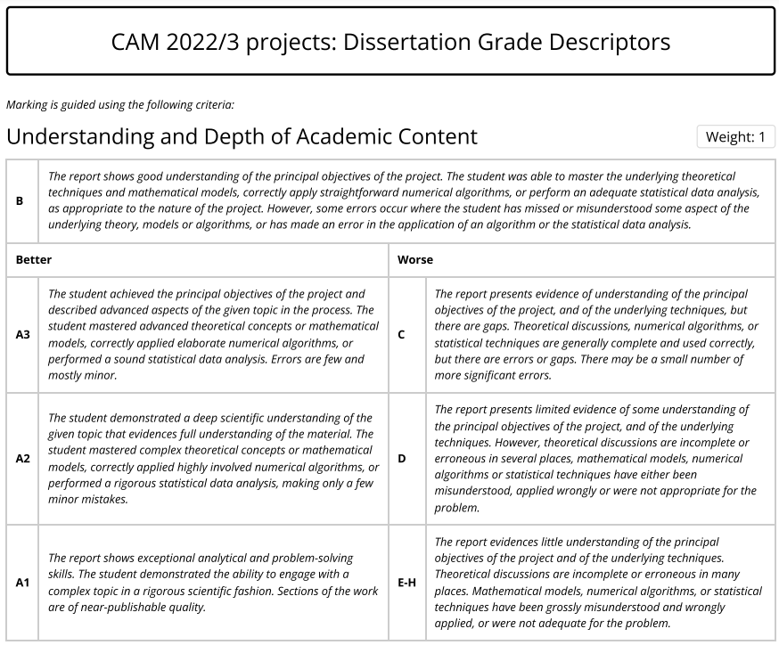
How to 'read' the descriptors
Grade B translates to 65%: the average score
Each criterion carries a weighting
To achieve a B, you should meet all or most elements of the criteria
Criteria C-E are ‘worse' than a B, i.e. they are a lower standard
Criteria A1-3 are ‘better' than a B, i.e. they are a higher standard

Slide 9
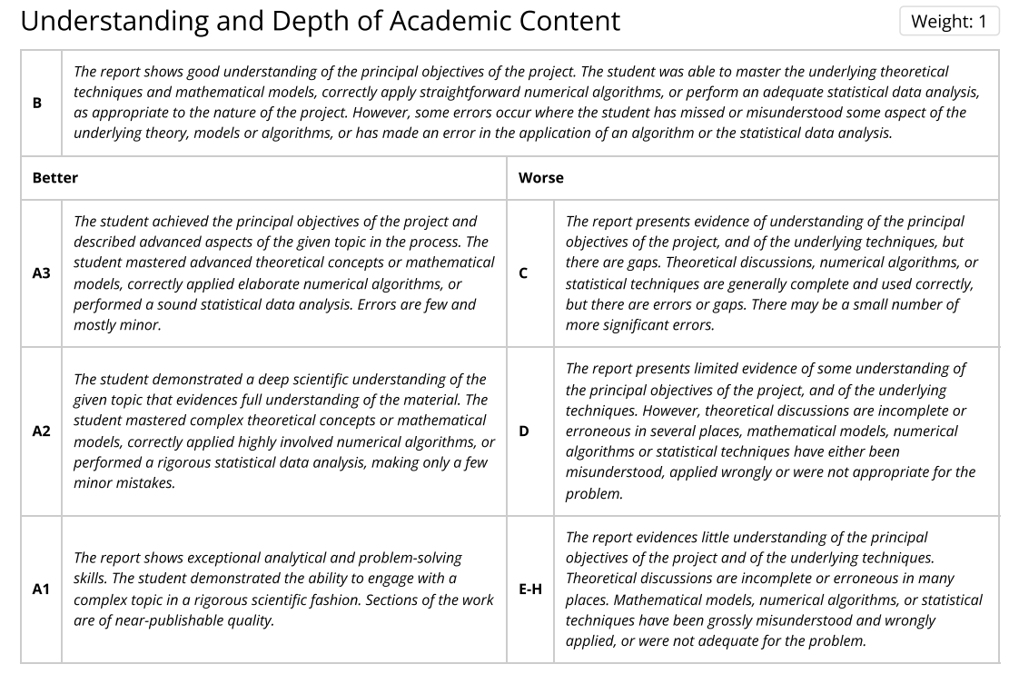
Focusing on a criterion
There are subtle differences in the descriptions for each grade
Let's focus on the grade descriptions for one category

Slide 10
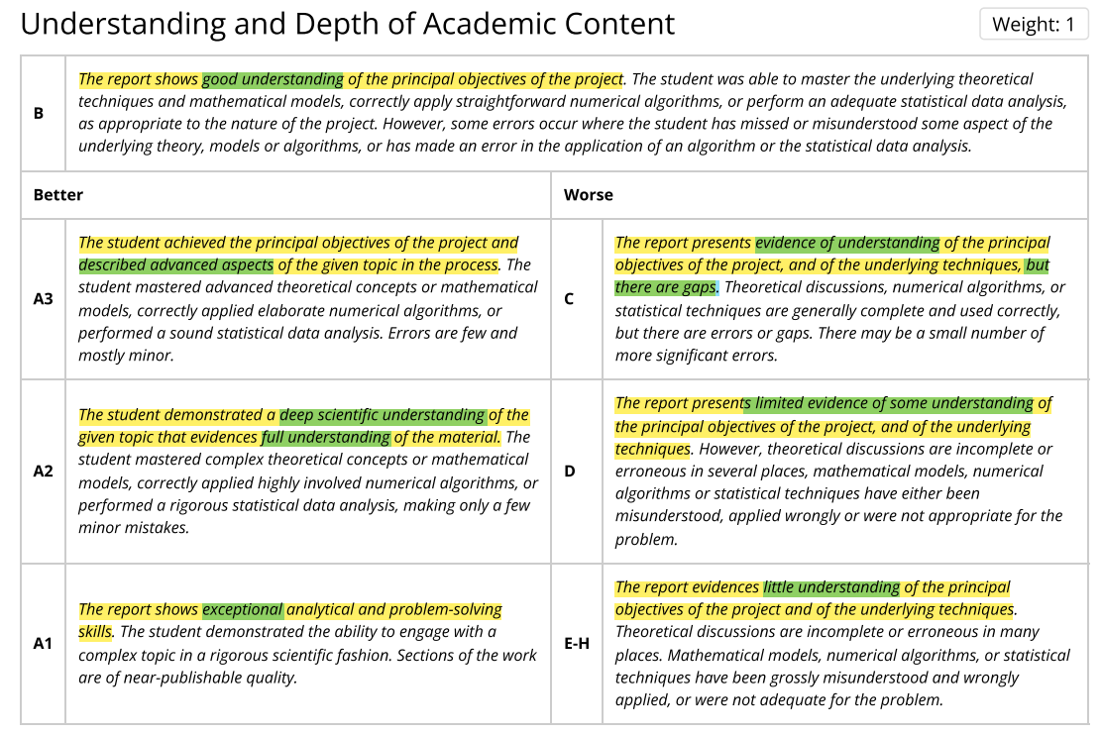
Focusing on a criterion
To understand the marker’s expectations, you need to be able to identify and understand the differences between each grade boundary.

Slide 11
The marking scheme: Task
To understand the marker’s expectations, you need to be able to identify and understand the differences between each grade boundary.
Task: Download the complete marking scheme. Underline or highlight the adjectives and adverbs in each descriptor.
(There’s an example on the following slide)

Slide 12
Obtaining an A3
Category | Criteria
Understanding and Depth of Academic Content | The student achieved the principal objectives of the project and described advanced aspects of the given topic in the process. The student mastered advanced theoretical concepts or mathematical models, correctly applied elaborate numerical algorithms, or performed a sound statistical data analysis. Errors are few and mostly minor.
Originality of Approach | The student came up with a few ideas to explore different research directions or alternative solution approaches. The student achieved some improvement over the background material by deriving new theoretical results or methodological constructions, extending or modifying existing models or algorithms, or applying new statistical techniques that are close to techniques covered in the syllabus. However, most original contributions are minor.
Amount of work done | All questions raised in the project description are addressed. The report gives a detailed explanation of the background material needed to understand the topic. Work done is evidenced through several theoretical contributions, the implementation of extensive models and algorithms, or a substantial statistical or numerical analysis.
Logic of Argument | The report presents the main steps in the mathematical, statistical, or computational reasoning that underlies the project, although there may be a small number of minor logical gaps, or details missing.

Slide 13
Obtaining an A3
Category | Criteria
Background and References | All sections of the report are adequately supported by references to relevant background and precursor items. References are chosen mostly from appropriate sources. The bibliography contains minor mistakes.
Validity and Assessment of Results | The presentation of the findings of the project, and the discussion of the validity of results is convincing and reliable. Conclusions are well founded and demonstrate awareness of the broader scientific aims of the project. However, minor inconsistencies may occur.
Presentation | The report is generally well laid out. Figures and tables are presented clearly, and captions are informative, although there may be a small number of minor cases where the presentation of figures is unclear. Formulae are in almost all cases unambiguous, and notation is generally well-defined where needed. The report is generally written in an appropriate style, perhaps with a small number of exceptions. Cross-references are generally used appropriately, perhaps with some minor gaps.

Slide 14
Key language points: Pause and think
Focus on the marking scheme:​
​
What are the key language points you should consider?

Slide 15
Key language points
Logical progression of argument​
Language accuracy (grammar, vocabulary)​
Academic style (use of cautious language, register, precise and concise)​
Clarity and cohesion​
Accurate referencing and citation from a wide range of sources

Slide 16
Understanding your audience: Pause and think
Who are you writing for?
How will this affect the information you include and the language that you use?

Slide 17
Your audience
An educated peer
A similar background to you
Literate in certain techniques, but less expert in others

Slide 18
Your audience
Assume:
A consistent level of reader knowledge
A general mathematical background including a basic background in your programme (Statistics and/or Operational Research)
The reader does not know all your sources

Slide 19
Audience: Points to consider
Provide definitions of terms and notations that you will be using
Always keep your audience in mind: ask yourself 'would my peers understand this?'
Share an extract with a friend: can they understand it?
Talk through your project

Slide 20
Your audience: Peer review
Ask a friend of family member to read a section of your text. Choose a reviewer who is not an expert in the topic of your investigation.​
Ask them to identify any sections that are difficult to understand.​
Consider how you could make these sections clearer.​​
With a peer on your course, you could do a more detailed peer review using the checklist accompanying this session.​

Slide 21


Review
Engaging with the marking criteria will help you understand the expectations of your marker
Understanding your audience will help you choose what information to include and the language you choose

Slide 22
Resources
Aliotta, M., 2018. Mastering academic writing in the sciences : a step-by-step guide. CRC Press.
Glasman-Deal, H. 2010. Science research writing for non-native speakers of English. World Scientific Publishing Co.
Higham, N.J. 1998. Handbook of writing for the mathematical sciences 2nd ed. Society for Industrial and Applied Mathematics

