Slide 1
Mathematics Dissertations
Structure and line of argument
English Language Education

Slide 2
Understanding the report structure
Developing and communicating a central argument
Using appropriate language to clearly state your objective

Slide 3
Structure and line of argument
Communicating your ideas clearly and effectively
Planning is essential- use a planning template
Each paragraph builds upon the previous paragraphs
A clear outline is essential
See Heard (2016) Chapter 7: Finding and telling your story for a very helpful overview of planning your line of argument

Slide 4

Structure and line of argument: Pause and think
How might this image help you in planning your structure?

Slide 5
Structure and line of argument
The spine is your line of argument, which should link your introduction with your conclusion.
The head of the fish represents your introduction.
The ribs are your sections or paragraphs. These should support your argument.
The tail represents your conclusion.

Slide 6
Pause and think
How might the fishbone image help you in your planning?

Slide 7
Understanding the report structure
Title, Abstract, Acknowledgements, Contents
Introduction
Main body
Conclusion
References/Bibliography, Appendices

Slide 8
Introduction
Introduces the research topic
Provides background
Includes relevant literature
States your aims
Outlines your paper
Define a research territory
Establish a niche
Occupy the niche

Slide 9
Introduction
Define a research territory
  Claim importance
  Make topic generalisations
  Review items of previous research
Establish a niche
  Raise a question
  Make a counter-claim
  Indicate a gap
Occupy the niche
  Outline your purposes
  Announce the present research
Define a research territory
Establish a niche
Occupy the niche

Slide 10
Pause and think
Define a research territory
  Claim importance
  Make topic generalisations
  Review items of previous research
Establish a niche
  Raise a question
  Make a counter-claim
  Indicate a gap
Occupy the niche
  Outline your purposes
  Announce the present research
What is your research territory?
What is your niche?
How will you occupy the niche?

Slide 11
Defining a research territory: Task
Access the dissertations at the links below.
Identify the different elements of an introduction:
The research territory
The niche
How the niche is occupied
Sample 1 MSc Dissertation
https://uoe.sharepoint.com/sites/schoolofmaths/students/Shared%20Documents/Forms/AllItems.aspx?id=%2Fsites%2Fschoolofmaths%2Fstudents%2FShared%20Documents%2FExample%20Projects%20and%20Dissertations%2FAutomated%20Code%20Generation%20for%20Simplified%20Glaciological%20Models%2Epdf&parent=%2Fsites%2Fschoolofmaths%2Fstudents%2FShared%20Documents%2FExample%20Projects%20and%20Dissertations&p=true&originalPath=aHR0cHM6Ly91b2Uuc2hhcmVwb2ludC5jb20vOmI6L3Mvc2Nob29sb2ZtYXRocy9zdHVkZW50cy9FY0VJeS1SWElGVkhrVTBaWkhvVF9VZ0JGWGU0Z085ZTNCM0pOcXNnOWNMaDh3P3J0aW1lPUNDSGpfWVlRMlVn
Sample 2 MSc Dissertation
https://uoe.sharepoint.com/sites/schoolofmaths/students/Shared%20Documents/Forms/AllItems.aspx?id=%2Fsites%2Fschoolofmaths%2Fstudents%2FShared%20Documents%2FOR%20MSc%2FMeeke%5FRoet%2DDissertation%2Epdf&parent=%2Fsites%2Fschoolofmaths%2Fstudents%2FShared%20Documents%2FOR%20MSc&p=true&originalPath=aHR0cHM6Ly91b2Uuc2hhcmVwb2ludC5jb20vOmI6L3Mvc2Nob29sb2ZtYXRocy9zdHVkZW50cy9FVklTTHVDNTJfUk5oZVk0RWxqVHc1SUIwS1B3RE1GWThHenVGX24wWHlRZXhBP3J0aW1lPVRJYkNKb2NRMlVn

Slide 12
Stating your objective
A clearly stated objective is important
Unclear objectives make it difficult for the reader to understand the purpose of your investigations

Slide 13
Stating your objective: Examples
The first aim of this dissertation is therefore to analyse the pilot data in detail. More specifically, it will be shown what kind of information is contained in the data, not only explicitly, but also implicitly… The second aim of this dissertation is to investigate whether it is possible to predict a person’s respiratory rate based on the signals collected by the RESpeck.
It is the intention of this thesis to provide an alternative approach to the detection of correlated well pairings and to elaborate on Li’s model with the implementation of a linear program which optimises the predicted short-term recovery via perturbation of injector well flow rate.
The aim of this thesis is to answer to the questions “Is it possible to improve scorecard profit by making extra scorecards to marginal populations?” and “Is it possible to improve scorecard profit by using more than one source of data for some part of the scorecard?”.
To demonstrate the use of FEniCS in solving real-world problems, we will examine PDE systems for several simplified glaciological models.

Slide 14
Stating your objective: Pause and think
What is your research objective?

Slide 15
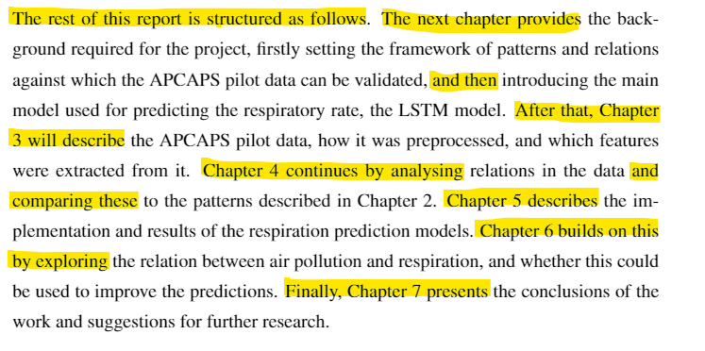
Presenting your outline
The reader should know the overall structure from the start
Present the main themes of each chapter
Sample Distinction dissertation from Mathematics webpage: https://uoe.sharepoint.com/sites/schoolofmaths/students/Shared%20Documents/Forms/AllItems.aspx?id=%2Fsites%2Fschoolofmaths%2Fstudents%2FShared%20Documents%2FOR%20MSc%2FMeeke%5FRoet%2DDissertation%2Epdf&parent=%2Fsites%2Fschoolofmaths%2Fstudents%2FShared%20Documents%2FOR%20MSc&p=true&originalPath=aHR0cHM6Ly91b2Uuc2hhcmVwb2ludC5jb20vOmI6L3Mvc2Nob29sb2ZtYXRocy9zdHVkZW50cy9FVklTTHVDNTJfUk5oZVk0RWxqVHc1SUIwS1B3RE1GWThHenVGX24wWHlRZXhBP3J0aW1lPWxaR0hiU1FLMlVn

Slide 16
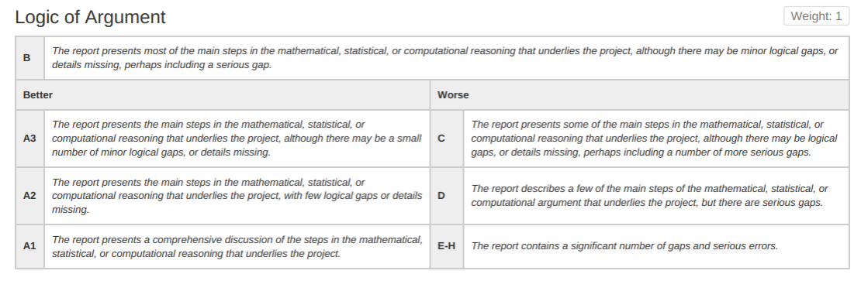
Main body
Content and sub-chapters different for each project
The bulk of your project
Logical progression of idea: a clear line of argument

Slide 17
Main body
Contents of the main body vary, and chapters and sub-chapters may cover some of the following:
Overview of code generation or data framework
Examples of models
Overview of methods
Implementation and results of models

Slide 18
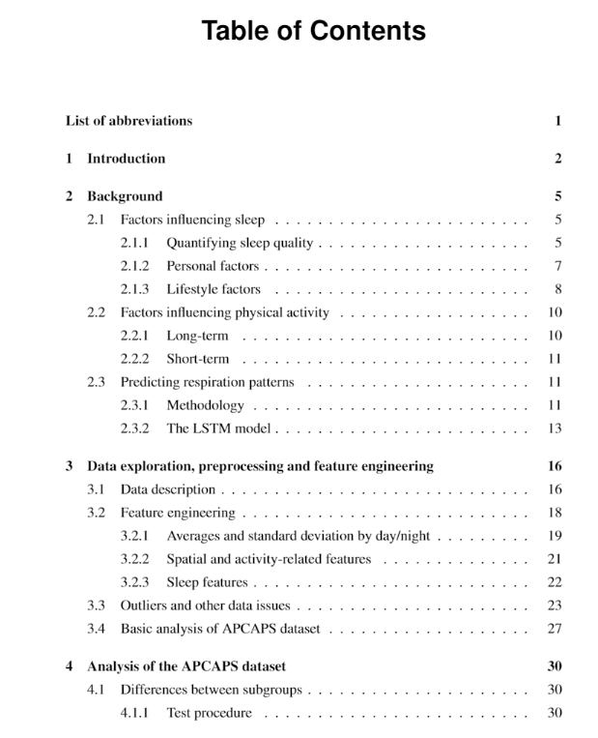
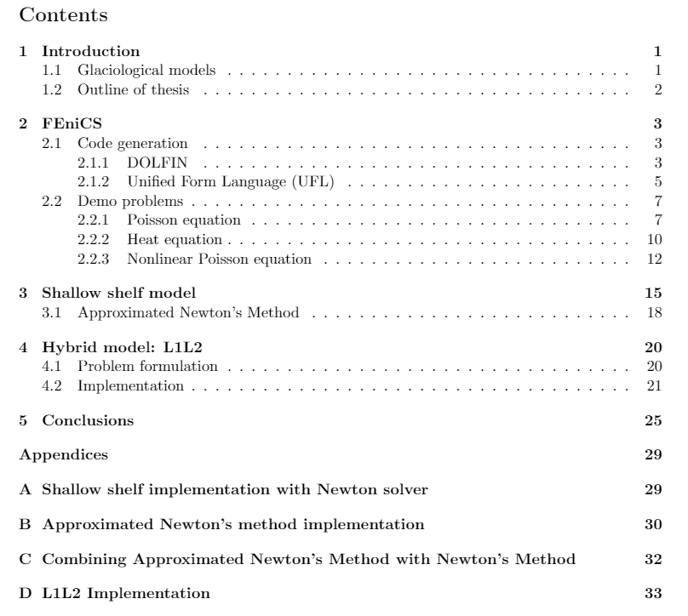
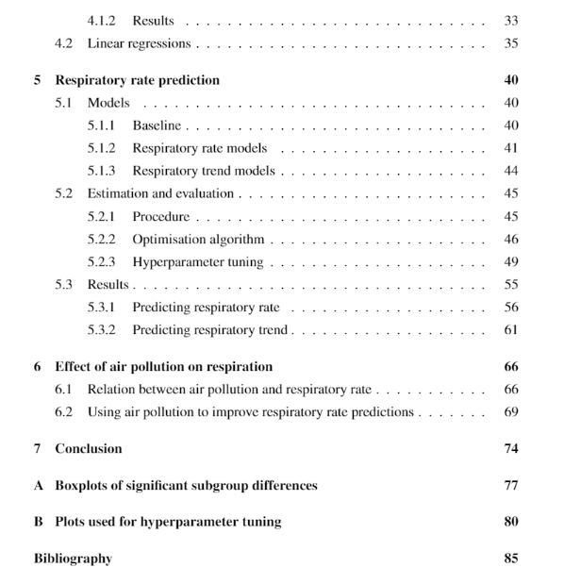
Sample contents page
Each section builds upon the previous sections and is an important component of the whole text
Each section helps you achieve your research objective

Slide 19
Main body: Pause and think
How many sections will you include in your main body?
What are they?

Slide 20
Conclusion
Validity, Analysis, and Assessment of Results:
(A1) A number of important questions for future research in the field are identified.
(B) There is satisfactory evidence that the findings presented in the report are derived from the background material and the existing data, and that they are correct overall. However, minor inconsistencies and mistakes do appear.
(D) The scarce findings presented in the report connect only weakly to the objectives of the project, and to a broader scientific enquiry.

Slide 21
Conclusion
Revisit your ideas and results
Present any limitations
Identify direction of future research
Restate your objective
Overview of main findings
Present any limitations
Direction of future research

Slide 22
Conclusion: Restating your purpose
Sample 1
Introduction: The first aim of this dissertation is therefore to analyse the pilot data in detail… The second aim of this dissertation is to investigate whether it is possible to predict a person’s respiratory rate based on the signals collected by the RESpeck.
Conclusion: The aims of this dissertation were twofold: firstly, the APCAPS pilot data was analysed in detail to confirm the value of the data collection using the RESpeck and the validity of the results. Secondly, the same RESpeck data was used to investigate if a person’s respiratory rate can be predicted ahead of time. It was also investigated how air pollution relates to respiration in people with asthma and COPD, and whether this could be utilised to improve the predictions.
Sample 2
Introduction: To demonstrate the use of FEniCS in solving real-world problems, we will examine PDE systems for several simplified glaciological models.
Conclusion: We have explored the functionality of FEniCS by solving several classic PDE problems, as well as studying several simplified glaciological models.

Slide 23
Conclusion: Future directions examples
Sample 1
For any future work on the topic, it is therefore highly recommended to devise a more advanced evaluation metric that describes the actual utility of a model better than looking at the MAE, RMSE, or percentage of predictions with the correct direction…
It may therefore be worthwhile to collect extra data on subjects with a high-variance respiratory rate, or to oversample such subjects when estimating the models…
Besides these suggestions, another major direction for future research is the relation-ship between air pollution and respiration, both in the context of respiratory rate pre-diction and general health.
Sample 2
Future work: As noted previously, in this report the final quantity calculated from the hybrid model is the depth-averaged velocity of the ice sheet. An obvious next step would be to calculate the surface velocity of the ice sheet, as this is actually an observable quantity and so solutions could be compared to physical observations. A possible model to solve for surface velocity is presented in [13]. Additionally, in all our experiments the vertical thickness of the ice was treated as constant. For a more physically realistic model, we may consider models in which the thickness of ice varies over the horizontal domain, or with time as examined in [9].

Slide 24
Returning to the fishbone
Overview of the subject.
Identifying an area of research.
Stating your objective.
Your objective is evident throughout
Restate objectives.
Overview of findings and any limitations.
Direction of future research.
Chapters and sub-chapters

Slide 25
Planning
To help you communicate effectively, consider the structure and argument before you begin writing.
Identify your objective
Outline your main sections- begin with main chapters then focus on any sub-chapters
Write a summary sentence for each section
How do you usually plan your writing?

Slide 26

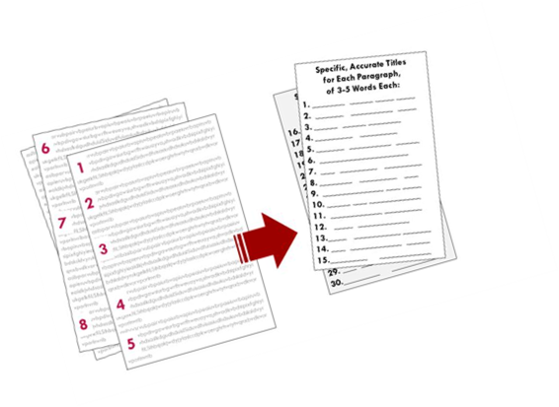
Checking your line of argument: Reverse outlining
1. In the left-hand margin, write down the topic of each paragraph.
2. In the right-hand margin, note how the paragraph topic advances the overall argument of your text.
or
1. Summarise the main idea of each paragraph in a blank document (topic sentence is fine if succinct) making a list.
2. Number the listed items for ease of reference.
Adapted from: https://owl.purdue.edu/owl/general_writing/the_writing_process/reverse_outlining.html​
and https://writing.wisc.edu/handbook/process/reverseoutlines/​
Examples from: https://sass.queensu.ca/onlineresource/topics/writing-topic-the-reverse-outline/​
and https://www.gvsu.edu/wc/reverse-outline-what-is-it-and-how-do-149.htm​

Slide 27
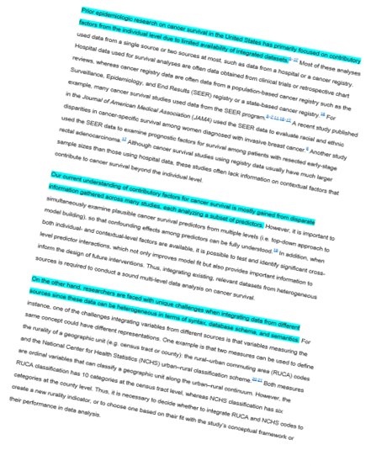

Checking your line of argument: Topic sentence outline
This is particularly useful for your introduction and conclusion
It is also useful for any larger sections of text within the main body of your project
Highlight the topic sentence (usually the first sentence). Read only the highlighted sentences: can you follow your argument?

Slide 28
Checking your line of argument: Topic sentence outline example
See how the topic sentences (first sentences of each paragraph) show the logical progression of ideas:
Partial differential equations (PDEs) are used in myriad disciplines to model physical phenomena, including fluid dynamics, electromagnetism, and mathematical biology.
The advantage of FEniCS over other software is that it uses compiler technology to generate software where possible instead of just compiling and integrating hand-coded software libraries [30].
To demonstrate the use of FEniCS in solving real-world problems, we will examine PDE systems for several simplified glaciological models.
We now present a brief overview of glaciological models which are studied in Chapters 3–4.

Slide 29
Checking your line of argument: Topic sentence outline example
DOLFIN is a library available as a part of the FEniCS Project that computes the automated solution of PDEs using the finite element method.
Automated code generation allows DOLFIN to efficiently assemble a variational form of any rank (i.e., of any number of arguments) from a large class of variational forms.
The central classes of DOLFIN include the linear algebra classes, mesh classes, finite element classes, and function classes.
Finite element assembly: The assemble function is one of the free functions provided by DOLFIN.
Solving variational forms: The solve function is another free function provided by DOLFIN, and is utilized in many of the problems examined further in this report.
Definition of DOLFIN
What DOLFIN does
DOLFIN classes
Expand on classes presented in the previous paragraph

Slide 30
Review of session
The fishbone representation of a longer text
The main sections of the report
The importance of a clear line of argument
Planning effectively to achieve a coherent line of argument
Reviewing your line of argument using reverse outlining and/or topic sentence outlining

Slide 31
References & further resources:
Heard, S. B. ( 2016). The Scientist’s Guide to Writing: How to write more easily and effectively throughout your scientific career. Princeton University Press.
http://www.phrasebank.manchester.ac.uk/
Aliotta, M. (2018). Mastering Academic Writing in the Sciences: A step by step guide. CRC Press.
Boyle, J., & Ramsay, S. (2018). Writing for Science Students. Macmillan International.
Glasman-Deal, H. (2010). Science Research Writing For Non-Native Speakers of English. Imperial College Press.

