Slide 1
Mathematics Dissertations
Style and clarity
English Language Education

Slide 2
Pause and think
What do you understand by style and clarity of writing in relation to your dissertation?
Notes:
Jenny to introduce the day and run through the agenda

Slide 3
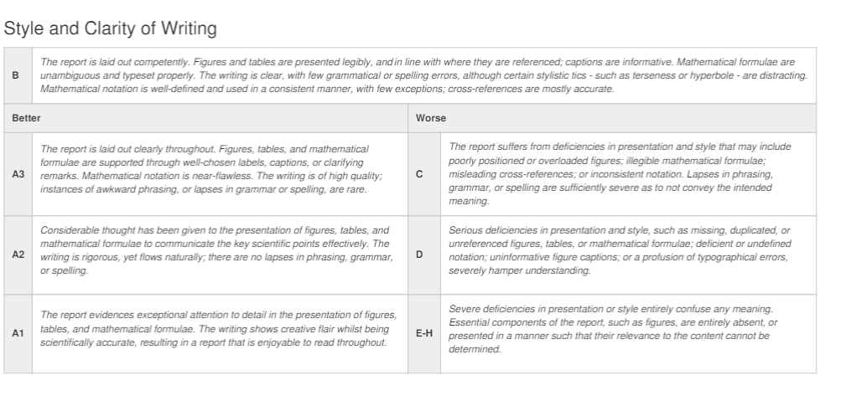
Style and clarity
Notes:
Jenny to introduce the day and run through the agenda

Slide 4
Style and Clarity
Presentation of figures, tables, and mathematical formulae
Clarity of writing
  Sentence structure and length
  Sentence and paragraph linking the maths
  Precise phrasing your argument
  Hedging and boosting
Notes:
Jenny to introduce the day and run through the agenda

Slide 5
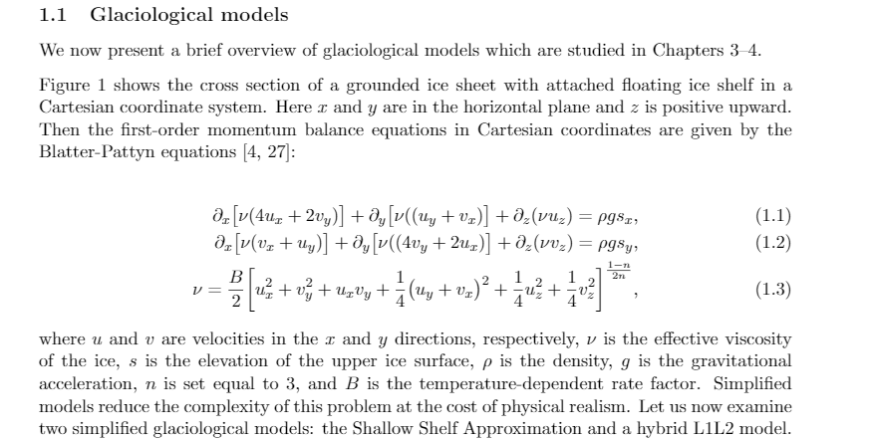
Presentation of figures, tables, and mathematical formulae
Notes:
Jenny to introduce the day and run through the agenda

Slide 6
Presentation of figures, tables, and mathematical formulae
  Invitation to view results
  Figure 1 shows the cross section of...
  As shown in Table 2, the total notional capacity is...
  The resulting unit reassignment and distribution of the capacity extensions can be seen in Figure 10.
  ....the current catchment area plan of the secondary schools is depicted in Figure 1.
  For instance, the catchment areas of schools 3 and 5 are both oddly-shaped with long outliers (Figure 2).
Notes:
Jenny to introduce the day and run through the agenda

Slide 7
Presentation of figures, tables, and mathematical formulae
  Task: Go to https://teaching.maths.ed.ac.uk/main/postgraduate-taught/msc-programmes/operational-research/assessment/projects/dissertations
  Access one or two of the sample good projects from the bottom of the page and notice how the writers present and integrate any figures, tables, and mathematical formulae.
  Match what you see to the descriptors in the marking criteria on
  Slide 3.
Notes:
Jenny to introduce the day and run through the agenda

Slide 8
Sentence structure and length
Which text is easier to read and why?
a) If g is positive, f is continuous, the domain of f is open, and we further invoke Lemma 2.3.6, then the set of points at which f ·g is differentiable is a set of the second category, provided that the space of definition of f is metrizable and separable.
b) Let x be a separable metric space. Let f be a continuous function that is defined on an open subset of x. Suppose that g is any positive function. Using Lemma 2.3.6, we see that the set of points at which f · g is differentiable is of second category.
Notes:
Jenny to introduce the day and run through the agenda

Slide 9
Sentence structure and length
Simple sentences are usually preferable when linking to the mathematics.
Generally for your dissertation, aim for sentences of 15-20 words and avoid very long sentences (over 40 words).
Where possible keep topic sentences at the beginning of paragraphs relatively short.
Notes:
Jenny to introduce the day and run through the agenda

Slide 10
Pause and think
How do you make the connections between sentences clear to the reader?
Notes:
Jenny to introduce the day and run through the agenda

Slide 11
Sentence and paragraph linking
Lexical cohesion and linking words
A more successful amendment is to add cuts to the problem formulation. Adding Type I cuts reduced the solution times and number of subproblems in some of the example cases. The most successful reduction of solution time could be observed on the 24 bus case. However, in the nine bus case the cuts mislead the solver so that the number of node evaluations is higher than in the standard case. Thus we know that an adverse effect may also occur when using cuts, so in each case it will be difficult to predict if a method will perform well or might even slow down the process..
Notes:
Jenny to introduce the day and run through the agenda

Slide 12
Sentence and paragraph linking
Controlling the flow of information
Pattern 1: Repeated topic (subject)
Gonnissen et al. (2013) observed a concurrent increase in obesity and decrease in average self-reported sleep duration. Examining these two trends in more detail, they found an inverse association between sleep duration and BMI, as well as changes in the sleep architecture related to BMI changes. They hypothesise that these changes in sleep architecture cause more fragmented sleep, which on its turn leads to less self-control and increased appetite during the day, resulting in a higher BMI. They also posit physical activity as a potential third factor driving both BMI and sleep duration, since less active people have a higher BMI on average and tend to sleep shorter.
Notes:
Jenny to introduce the day and run through the agenda

Slide 13
Sentence and paragraph linking
Pattern 2: Linking Pattern
By wearing the RESpeck at night, subjects collected data during their sleep, albeit less than in a targeted sleep study. These data were used to derive several indicators of sleep quality, inspired by the standard measures identified in Section 2.1.1.
First of all, the number of sleep interruptions per night was calculated by counting how often the subject’s activity type changed to something different than lying down during the night (excluding ‘wrong orientation’ and ‘undetermined’). While this calculation excludes awakenings without getting up and shifts in sleep stage....
Notes:
Jenny to introduce the day and run through the agenda

Slide 14
Sentence and paragraph linking
Pattern 3: Topic > sub-topics
Sleep is characterised by four phases (Riley et al., 1985). Stage N1 is the first, in which a person is in very light sleep or a drowsy state. This is followed by stage N2 and N3, both deeper than their predecessor stage. Stage N3 is when events like sleep walking and sleep talking occur. It is also called slow-wave sleep (SWS) or delta sleep. The final stage is Rapid Eye Movement (REM) sleep, in which the body becomes almost completely paralysed.
Notes:
Jenny to introduce the day and run through the agenda

Slide 15
Paragraph and section linking: transitional words and phrases
Dissertation 1 | Dissertation 2
Hence, there are... | However,
In contrast to... | Because of this,...
First, we observe... | Although these studies...
As a second step,... | The objective of such a model...
This is an unexpected result... | This change leads to...
This approach showed... | In contrast to...
To approach these issues... | Another approach...
In the above section we have outlined.. | Additionally,...
In the preceding sections we have seen.. | As mentioned before...
Nevertheless,.. | This procedure...
However, a particular advantage of.. | Again,...
Again, | Lastly,...
Notes:
Jenny to introduce the day and run through the agenda

Slide 16
Sentence and paragraph linking: overlapping vocabulary
...from traditional and DC UC are still identical in all but the 57 bus case. However, taking line limits into account can yield better estimates for the final (AC OPF) cost. Nevertheless, the only case where we observed that the DC UC model can find better commitment decisions than the traditional UC model is the 57 bus case.
Ultimately, the question whether traditional or DC UC is more appropriate is of secondary importance as we observed AC infeasibilities in the six and 24 bus cases. But in order to improve unit commitment models their results need to be AC feasible, so that they can actually be implemented.
Notes:
Jenny to introduce the day and run through the agenda

Slide 17
Sentence and paragraphing linking
  Task: Go to https://teaching.maths.ed.ac.uk/main/postgraduate-taught/msc-programmes/operational-research/assessment/projects/dissertations
  Again, access one or two of the sample good dissertations, but this time notice how the writers link paragraphs and sections together.
  Take a note of any transitional phrases that they use. Can you find any examples of overlapping vocabulary between the end of one paragraph/section and the beginning of the next one?
Notes:
Jenny to introduce the day and run through the agenda

Slide 18
Precise phrasing
Compare:
Gonnissen et al. (2013) observed an increase in obesity and decrease in sleep. Examining these in detail, they found an association, between sleep duration and BMI...
Gonnissen et al. (2013) observed a concurrent increase in obesity and decrease in average self-reported sleep duration. Examining these two trends in more detail, they found an inverse association between sleep duration and BMI...
Notes:
Jenny to introduce the day and run through the agenda

Slide 19
Hedging and boosting
Hedging: Showing caution
The plots for subjects CA01, SA05 and SA07 are almost counterintuitive, because there is no correlation or even a negative one to PM1 and PM2.5. A possible explanation is that their medication mitigates the effect of air pollution.
Future studies could focus on the influence of different data on the results or on exploring more model variations. Data-wise one could look at how the existing results change when the time period is extended or decreased from 6 years or come up with different ways of generating and handling the population data. Model-wise there are a lot of options, though this might again be highly situation-dependent.
Nevertheless, in terms of computational cost coarse data files seem more successful than move blockers, so we will use this approximation type for all following test runs.
Notes:
Jenny to introduce the day and run through the agenda

Slide 20
Hedging and boosting
Boosting: Showing confidence
This demonstrates that we need to be aware of these parameters because they can decide on success or failure of the whole method if the underlying problem has tight margins on the line flows and voltage bounds.
Although it is feasible to set a switch variable....this is clearly not optimal as the generator cannot actually be switched on but the associated cost is incurred anyway.
The reason for these infeasibilities is decommitment of generators at buses seven and 16 in deterministic planning.
Notes:
Jenny to introduce the day and run through the agenda

Slide 21
Pause and think
How would you decide when to hedge and when to be more confident?
Notes:
Jenny to introduce the day and run through the agenda

Slide 22
Key messages from session
Pay careful attention to the presentation and integration of figures, tables, and mathematical formulae.
Try and keep sentences relatively short and simple when guiding the reader through the maths.
Make sure that the connections between sentences within individual paragraphs are clear to the reader.
Use appropriate words and phrases and/or overlapping vocabulary to create smooth transitions across paragraphs/sections.
Remember the importance of being precise in your use of language
Reflect on when it might be appropriate to hedge statements and when you could be more confident
Notes:
Jenny to introduce the day and run through the agenda

Slide 23
References & further resources:
Aliotta, Marialuisa. (2018). Mastering academic writing in the sciences: A step-by-step guide. Boca Raton: CRC Press.
Heard, Stephen B. (2016). The scientist's guide to writing. Princeton: Princeton University Press.
Krantz, Steven G. (2017). A primer of mathematical writing (Vol. 243). American Mathematical Soc..
Matthews, Janice R, & Matthews, Robert W. (2014). Successful Scientific Writing. Cambridge University Press. (online Library access)
http://www.uefap.net/writing/writing-paragraphs/writing-paragraphs-cohesion
http://www.uefap.net/writing/writing-paragraphs/writing-paragraphs-flow
https://www.monash.edu/rlo/research-writing-assignments/writing/clear-communication/writing-clearly-concisely-and-precisely
https://www.phrasebank.manchester.ac.uk/

