Slide 1
Mathematics Dissertations SwDS
Understanding the marking scheme & your audience
English Language Education

Slide 2
Understanding expectations for your consultancy report project: unpacking the criteria.
Understanding your audience.
Notes:
Lisa and Thomas to introduce themselves

Slide 3
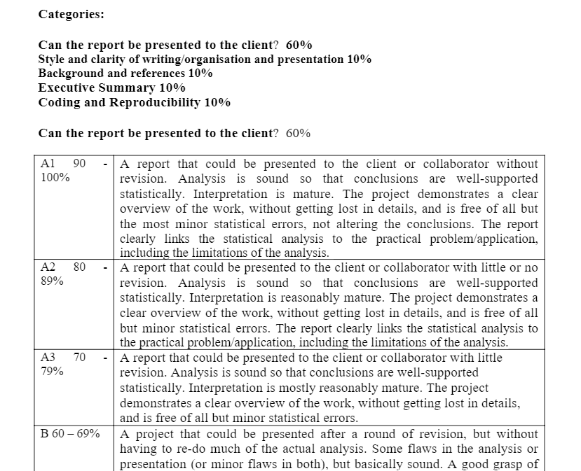
The marking scheme
Descriptor templates New Consultancy Projects Marking Scheme SwDS
Notes:
Jenny to introduce the day and run through the agenda

Slide 4
The marking scheme: Pause and think
Download the marking scheme.
How many criteria are being graded?
Which is the most important criteria?
Notes:
Jenny to introduce the day and run through the agenda

Slide 5
The marking scheme: Pause and think
How many criteria are being graded?
Which is the most important criteria?
They are equally important.
Each criteria feeds into your final grade despite different weightings.
Can the report be presented to the client? 60%
Style and clarity of writing/organisation and presentation 10%
Background and references 10%
Executive Summary 10%
Coding and Reproducibility 10%
Notes:
Jenny to introduce the day and run through the agenda

Slide 6
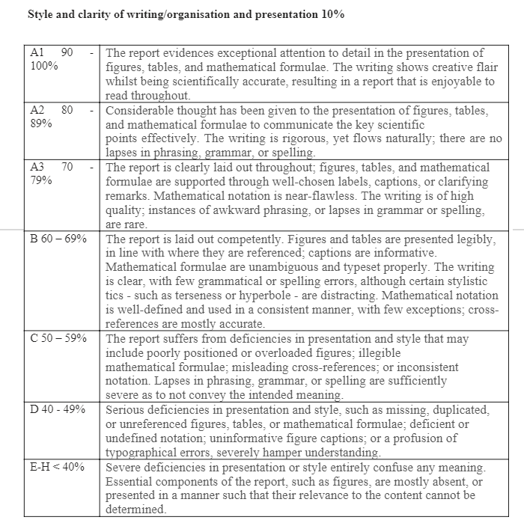
How to 'read' the descriptors
Each criteria is essential to the whole project, even if the weighting is lower. If you are deficient in one criteria, it is harder to obtain a high grade.
Grade B translates to 60-69%: the average grade
To achieve a B, you should meet all or most elements of the criteria
Notes:
Jenny to introduce the day and run through the agenda

Slide 7
The criteria: What do they mean?
Can the report be presented to the client? 60%​
Extent to which your report meets the brief, accuracy of information and conclusions drawn from data
Style and clarity of writing/organisation and presentation 10%​
Professional and accurate presentation and use of language
Background and references 10%​
The literature you use to support your ideas and argument and the accuracy of your bibliography
Executive Summary 10%​
A precise and concise overview of the report, a research-informed conclusion
Coding and Reproducibility 10%
Accuracy of coding and the extent to which someone could copy your coding process
Notes:
Lisa:
On your tables, shout about what you’re proud that you or the team you work in have accomplished this year?
When noting your examples,
Notepads and pens on tables – please write them down
5 min feedback: 2 examples per table. Take moment to acknowledge positive change and hard work to achieve these successes. A lot of hard work and time goes into making these changes.

Slide 8
Use of language: Pause and think
Look at the marking scheme again.
Which criteria refer to academic language and style?
Notes:
Lisa:
On your tables, shout about what you’re proud that you or the team you work in have accomplished this year?
When noting your examples,
Notepads and pens on tables – please write them down
5 min feedback: 2 examples per table. Take moment to acknowledge positive change and hard work to achieve these successes. A lot of hard work and time goes into making these changes.

Slide 9
Use of language
These dissertation resources focus on academic language and literacy:
Can the report be presented to the client? 60%
Style and clarity of writing/organisation and presentation 10%
Background and references 10%
Executive Summary 10%
Coding and Reproducibility 10%
Notes:
Lisa:
On your tables, shout about what you’re proud that you or the team you work in have accomplished this year?
When noting your examples,
Notepads and pens on tables – please write them down
5 min feedback: 2 examples per table. Take moment to acknowledge positive change and hard work to achieve these successes. A lot of hard work and time goes into making these changes.

Slide 10
Focusing on a descriptor
There are subtle differences in the descriptors for each grade. Let's focus on the language component in the Style and Clarity of Writing criteria:
Grade | Descriptor
A1 90-100% | A report that is enjoyable to read throughout
A2 80-89% | There are no lapses in phrasing, grammar or spelling
A3 70-79% | Instances of awkward phrasing, or lapses in grammar are rare
B 60-69% | Few grammatical or spelling errors, although certain stylistic tics - such as terseness or hyperbole - are distracting
C 50-59% | Lapses in phrasing, grammar, or spelling are sufficiently severe as to not convey the intended meaning.
Notes:
Lisa:
On your tables, shout about what you’re proud that you or the team you work in have accomplished this year?
When noting your examples,
Notepads and pens on tables – please write them down
5 min feedback: 2 examples per table. Take moment to acknowledge positive change and hard work to achieve these successes. A lot of hard work and time goes into making these changes.

Slide 11
The marking scheme: Task
To understand the markers expectations, you need to be able to identify and understand the differences between each grade boundary.
Task: Download the complete marking scheme. Underline or highlight the adjectives and adverbs in each descriptor
Example on the following slide...
Notes:
Lisa:
On your tables, shout about what you’re proud that you or the team you work in have accomplished this year?
When noting your examples,
Notepads and pens on tables – please write them down
5 min feedback: 2 examples per table. Take moment to acknowledge positive change and hard work to achieve these successes. A lot of hard work and time goes into making these changes.

Slide 12
Obtaining an A3
Category | Criteria
Style and clarity of writing/ organisation and presentation | The report is clearly laid out throughout; figures, tables, and mathematical formulae are supported through well-chosen labels, captions, or clarifying remarks. Mathematical notation is near-flawless. The writing is of high quality; instances of awkward phrasing, or lapses in grammar or spelling, are rare.
Background and references | All sections of the report are adequately supported by references to relevant background and precursor items. References are chosen mostly from the scientific literature and may include books, published articles, or arXiv preprints. The bibliography contains minor mistakes.
Executive summary | The executive summary sets out a clear description of the problem under investigation and summarizes the statistical findings in a manner that can be understood by a researcher within a different area of expertise. A good attempt is made to recommend a solution to the problem under investigation and includes most important recommendations the statistical analysis reveals.
Notes:
Jenny to introduce the day and run through the agenda

Slide 13
Key language points: Pause and think
Focus on the 3 categories related to academic language.
What are the key language points you should consider?
Notes:
Lisa:
On your tables, shout about what you’re proud that you or the team you work in have accomplished this year?
When noting your examples,
Notepads and pens on tables – please write them down
5 min feedback: 2 examples per table. Take moment to acknowledge positive change and hard work to achieve these successes. A lot of hard work and time goes into making these changes.

Slide 14
Key language points
Logical progression of argument
Language accuracy (grammar, vocabulary)
Academic style (use of cautious language, register, precise and concise)
Clarity and cohesion
Accurate referencing and citation from a wide range of sources
Notes:
Lisa:
On your tables, shout about what you’re proud that you or the team you work in have accomplished this year?
When noting your examples,
Notepads and pens on tables – please write them down
5 min feedback: 2 examples per table. Take moment to acknowledge positive change and hard work to achieve these successes. A lot of hard work and time goes into making these changes.

Slide 15
Understanding your audience: Pause and think
Who are you writing for?
How will this affect the information you include and the language that you use?
Notes:
Jenny to introduce the day and run through the agenda

Slide 16
Your audience
Note that the executive summary grade A3 says: "The executive summary sets out a clear description of the problem under investigation and summarizes the statistical findings in a manner that can be understood by a researcher within a different area of expertise."
A consultancy client who is not necessarily a mathematics expert
You can imagine you are writing for a friend or family member who does not study your field of Mathematics or Science
Notes:
Lisa:
On your tables, shout about what you’re proud that you or the team you work in have accomplished this year?
When noting your examples,
Notepads and pens on tables – please write them down
5 min feedback: 2 examples per table. Take moment to acknowledge positive change and hard work to achieve these successes. A lot of hard work and time goes into making these changes.

Slide 17
Your audience: What does this mean?
An individual familiar with the field of investigation should be able to understand the report
Always keep your audience in mind- ask yourself 'would a non-expert understand this?'
This means you should, for example, provide definitions of terms and notations e.g.
When the count process is Poisson, this model is called a zero-inflated Poisson (ZIP). Models using NB processes are similarly referred to as zero-inflated negative binomial (ZINB) models. The ZIP model accounts for overdispersion via an excess of zeros, whilst ZINB accounts for overdispersion via an excess of zeros and overdispersion amongst the counts themselves.
Notes:
Lisa:
On your tables, shout about what you’re proud that you or the team you work in have accomplished this year?
When noting your examples,
Notepads and pens on tables – please write them down
5 min feedback: 2 examples per table. Take moment to acknowledge positive change and hard work to achieve these successes. A lot of hard work and time goes into making these changes.

Slide 18
Your audience: Peer review
Ask a friend of family member to read a section of your text. Choose a reviewer who is not an expert in the topic of your investigation.
Ask them to identify any sections that are difficult to understand.
Consider how you could make these sections clearer.
With a peer on your course you could do a more detailed peer review using the checklist accompanying this session.
Notes:
Lisa:
On your tables, shout about what you’re proud that you or the team you work in have accomplished this year?
When noting your examples,
Notepads and pens on tables – please write them down
5 min feedback: 2 examples per table. Take moment to acknowledge positive change and hard work to achieve these successes. A lot of hard work and time goes into making these changes.

Slide 19
Final note
The Writing Reports presentation on Learn contains detailed advice and examples.
Go to:
Learn Dissertation (SDS) (2020-2021)[SB5+]
Resources / Project Guidelines folder
The guiding questions for each section will help you plan and structure your report
Notes:
Lisa:
On your tables, shout about what you’re proud that you or the team you work in have accomplished this year?
When noting your examples,
Notepads and pens on tables – please write them down
5 min feedback: 2 examples per table. Take moment to acknowledge positive change and hard work to achieve these successes. A lot of hard work and time goes into making these changes.

Slide 20


Review
Engaging with the marking criteria will help you understand the expectations of your marker ​
Understanding your audience will help you choose what information to include and the language you use

Slide 21
Resources
Aliotta, M., 2018. Mastering academic writing in the sciences : a step-by-step guide. CRC Press.
Glasman-Deal, H. 2010. Science research writing for non-native speakers of English. World Scientific Publishing Co.
Higham, N.J. 1998. Handbook of writing for the mathematical sciences 2nd ed. Society for Industrial and Applied Mathematics

