Slide 1
Mathematics Consultancy Project
Structure and line of argument
English Language Education

Slide 2
Understanding the report structure
Developing and communicating a central argument
Using appropriate language to clearly state your objective
Notes:
Lisa and Thomas to introduce themselves

Slide 3
Structure and line of argument
Communicating your ideas clearly and effectively
Planning is essential- use a planning template
Each paragraph builds upon the previous paragraphs
A clear outline is essential
Notes:
Jenny to introduce the day and run through the agenda

Slide 4

Structure and line of argument: Pause and think
How might this image help you in planning your structure?
Notes:
Jenny to introduce the day and run through the agenda

Slide 5
Structure and line of argument
The spine is your line of argument, which should link your introduction with your conclusion.
The head of the fish represents your introduction.
The ribs are your sections or paragraphs. These should support your argument.
The tail represents your conclusion.
Notes:
Jenny to introduce the day and run through the agenda

Slide 6
Pause and think
How might the fishbone image help you in your planning?
Notes:
Jenny to introduce the day and run through the agenda

Slide 7
Understanding the report structure: IMRaD
Title, contents page, executive summary
Introduction
Methods
Results
Conclusion
References/ bibliography, appendices
Notes:
Jenny to introduce the day and run through the agenda

Slide 8
Introduction
Introduces the research topic
Provides background
Includes relevant literature
States your aims
Outlines your paper
Define a research territory
Establish a niche
Occupy the niche
Notes:
Jenny to introduce the day and run through the agenda

Slide 9
Introduction
Define a research territory
  Claim importance
  Make topic generalisations
  Review items of previous research
Establish a niche
  Raise a question
  Make a counter-claim
  Indicate a gap
Occupy the niche
  Outline your purposes
  Announce the present research
Define a research territory
Establish a niche
Occupy the niche
Notes:
Jenny to introduce the day and run through the agenda

Slide 10
Defining a research territory
1 Introduction
Rising sea-levels due to global warming are becoming an increasing problem throughout the world. In order to accurately predict future rises, a better understanding of one of the main causes, melting icesheets in Greenland and Antarctica, is crucial. To achieve this, satellite altimetry using radar waves has been used in the past (Nilsson et al. 2016, McMillan et al. 2018) to measure elevation changes of these ice-sheets. Initially being limited by low resolution, recent advances such as Synthetic Aperture Radar Interferometry (SARIn) used on the CryoSat-2 mission make it possible to cover larger areas with a much finer temporal as well as spatial coverage of up to 500m (Gourmelen et al. 2017). However, these measurements remain less accurate than Lidar data, as the penetration of radar waves into snow and firn varies. Lidar data is mostly collected in airborne campaigns, such as the NASA Operation IceBridge (OIB) campaign (NASA 2018), that are limited to selected areas and highly influenced by weather conditions. This data can therefore not be used as a substitute for radar measurements. In this paper we focus on reducing the error of the radar measurements using machine learning techniques, with a focus on recurrent neural networks (RNNs). We evaluate the improvements using local Lidar measurements, which has been common practice in this field of research (McMillan et al. 2018, Gourmelen et al. 2017). The main focus of this paper lies on creating a model that is able to extrapolate learned elevation adjustments to new areas which were not used during the training of the model.
Defining the research territory (importance)
Establishing a niche (indicating a gap)
Occupying the niche (stating the purpose)
Notes:
Jenny to introduce the day and run through the agenda

Slide 11
Pause and think
Define a research territory
  Claim importance
  Make topic generalisations
  Review items of previous research
Establish a niche
  Raise a question
  Make a counter-claim
  Indicate a gap
Occupy the niche
  Outline your purposes
  Announce the present research
What is your research territory?
What is your niche?
How will you occupy the niche?
Notes:
Jenny to introduce the day and run through the agenda

Slide 12
Stating your objective: Examples
This paper aims to provide a small contribution to the literature on AMR by examining the effect of prescription rates in a hospital setting.
This project aims to offer a model to estimate the LOLE for joint systems.
In this paper we focus on reducing the error of the radar measurements using machine learning techniques, with a focus on recurrent neural networks (RNNs). We evaluate the improvements using local Lidar measurements, which has been common practice in this field of research (McMillan et al. 2018, Gourmelen et al. 2017). The main focus of this paper lies on creating a model that is able to extrapolate learned elevation adjustments to new areas which were not used during the training of the model.
This report aims to contribute to this discussion by examining the risk factors behind HCC diagnosis. We hope that a better understanding of the causes of HCC development can help inform the design of surveillance programmes in the future
Notes:
Jenny to introduce the day and run through the agenda

Slide 13
Stating your objective: Pause and think
What is your research objective?
Notes:
Jenny to introduce the day and run through the agenda

Slide 14
Presenting your outline
The reader should know the overall structure from the start
Briefly present a summary of the outline
We will give a short overview of satellite altimetry as well as RNNs in the next section. We then introduce the data used for the analysis and the machine learning models we applied. In Section 5 we present our findings and conclude with possible improvements and future research.
Notes:
Jenny to introduce the day and run through the agenda

Slide 15
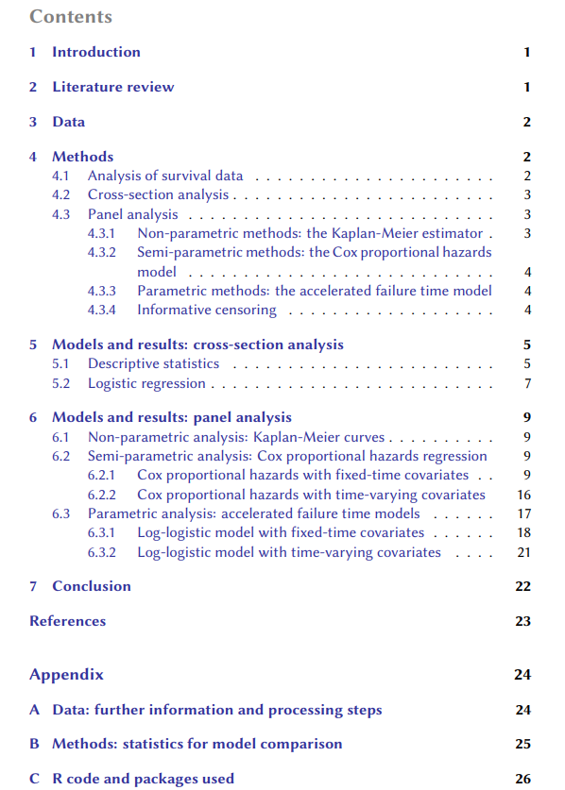
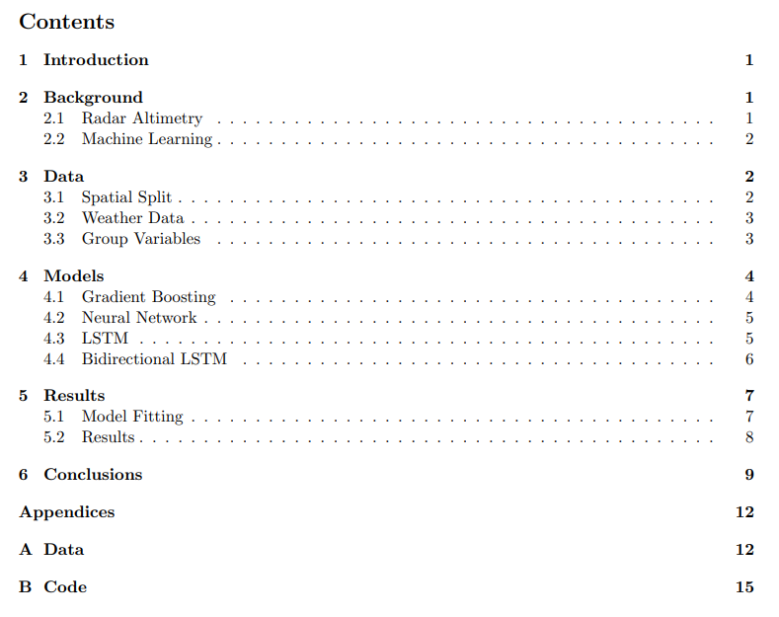
Sample contents page: The main body
Different for every project
Each section builds upon the previous sections and is an important component of the whole text
Notes:
Jenny to introduce the day and run through the agenda

Slide 16
Main body: Pause and think
How many sections will you include in your main body?
What are they?
Notes:
Jenny to introduce the day and run through the agenda

Slide 17
Conclusion
Revisit your ideas and results
Present any limitations
Identify direction of future research
Restate your objective
Overview of main findings
Present any limitations
Direction of future research
Notes:
Jenny to introduce the day and run through the agenda

Slide 18
Conclusion: Restating your purpose
Sample 1
Introduction: This report aims to contribute to this discussion by examining the risk factors behind HCC diagnosis. We hope that a better understanding of the causes of HCC development can help inform the design of surveillance programmes in the future
Conclusion: We analysed a sample of subjects undergoing HCC surveillance in Scotland with the goal of determining which factors—among aetiology of liver disease, age, sex and AFP levels—were important for explaining HCC diagnosis.
Sample 2
Introduction: This paper aims to provide a small contribution to the literature on AMR by examining the effect of prescription rates in a hospital setting.
Conclusion: The objective of this paper was to establish if there exists an association between drug use (measured in DDD/1000 OBD) and AMR (measured by proportion of clinical isolates exhibiting resistance) at the hospital level, using a Bayesian orderd logit model.
Notes:
Jenny to introduce the day and run through the agenda

Slide 19
Conclusion: Example
The objective of this paper was to establish if there exists an association between drug use (measured in DDD/1000 OBD) and AMR (measured by proportion of clinical isolates exhibiting resistance) at the hospital level, using a Bayesian orderd logit model. We find a 95% probability of a positive association between DDD and AMR for invasively administered drugs, with a 97% probability that non-invasive administration leads to a smaller association between DDD and AMR. This latter association may even be negative, however the probability of this is only 80% which is too small to draw conclusions from. The relative importance of invasively administered DDD in determining the proportion group is small, with a minimum transition ratio of 23.65 for a bottom to bottom transition. These ratios were smallest at more extreme proportions, perhaps implying a tipping-point phenomenon. In general, resistance mostly arises from a few drugs - namely amoxicillin, doxycycline, and trimethoprim. The drugs with the most negative association were linzolid, meropenem, and metronidazole. We have also suggested an alternative model (ZOIB), and how it might be improved by accounting for the natural ordering in the data, which is currently ignored. Marginalisation is also an attractive proposition. Concerns involve the generalisability of the model due to the subpopulation of a single hospital which could mean ignored hospital-specific or location-specific effects. The average age of patients is also very high, with the minimum average age on a ward-week being 45. Additionally, there may be selection bias due to the study being in a hospital setting where people are already ill. There is also the concern of the model’s poor predictive performance, even when considering the purposefully overfit model.
Identify:
1. Restated objective
2. Overview of main findings
3. Limitations
4. Direction of future research
Notes:
Jenny to introduce the day and run through the agenda

Slide 20
Conclusion: Example
The objective of this paper was to establish if there exists an association between drug use (measured in DDD/1000 OBD) and AMR (measured by proportion of clinical isolates exhibiting resistance) at the hospital level, using a Bayesian orderd logit model. We find a 95% probability of a positive association between DDD and AMR for invasively administered drugs, with a 97% probability that non-invasive administration leads to a smaller association between DDD and AMR. This latter association may even be negative, however the probability of this is only 80% which is too small to draw conclusions from. The relative importance of invasively administered DDD in determining the proportion group is small, with a minimum transition ratio of 23.65 for a bottom to bottom transition. These ratios were smallest at more extreme proportions, perhaps implying a tipping-point phenomenon. In general, resistance mostly arises from a few drugs - namely amoxicillin, doxycycline, and trimethoprim. The drugs with the most negative association were linzolid, meropenem, and metronidazole. We have also suggested an alternative model (ZOIB), and how it might be improved by accounting for the natural ordering in the data, which is currently ignored. Marginalisation is also an attractive proposition. Concerns involve the generalisability of the model due to the subpopulation of a single hospital which could mean ignored hospital-specific or location-specific effects. The average age of patients is also very high, with the minimum average age on a ward-week being 45. Additionally, there may be selection bias due to the study being in a hospital setting where people are already ill. There is also the concern of the model’s poor predictive performance, even when considering the purposefully overfit model.
Restated objective
Overview of main findings
Limitations
Direction of future research
Notes:
Jenny to introduce the day and run through the agenda

Slide 21
Returning to the fishbone
Overview of the subject
Identifying an area of research
Stating your objective
Your objective is evident throughout
Chapters and sub-chapters
Restate objectives
Overview of findings and any limitations
Direction of future research
Notes:
Jenny to introduce the day and run through the agenda

Slide 22
The executive summary
Description of the problem
Summary of findings
Proposed solution
Non-technical
Precise and concise
Notes:
Jenny to introduce the day and run through the agenda

Slide 23
Sample executive summary
Antimicrobial resistance (AMR) is a big threat, with a low estimate placing the potential death toll due to AMR in 2050 at 10,000,000 (O’Neill, 2016). Studies at the individual (Costelloe et al., 2010) and population (Goossens et al., 2005) level show a positive association between drug use and AMR – our goal is to investigate this association in a hospital setting. Using a Bayesian ordered logit model with drug-varying intercepts, we conclude there is a 95% probability of a positive association between drug use and resistance – specifically for invasively administered drugs. Additionally, there is a 97% probability that this association is smaller when considering non-invasive administration. Both these effects are very small in magnitude, and poor predictive performance means these results should be looked upon sceptically. We also propose a potential idea to expand the zero-one-inflated beta model that could account for ordering, and may be a good model for similar such studies
Identify:
1. Description of the problem
2. Summary of findings
3. Proposed solution
Notes:
Lisa:
On your tables, shout about what you’re proud that you or the team you work in have accomplished this year?
When noting your examples,
Notepads and pens on tables – please write them down
5 min feedback: 2 examples per table. Take moment to acknowledge positive change and hard work to achieve these successes. A lot of hard work and time goes into making these changes.

Slide 24
Sample executive summary
Antimicrobial resistance (AMR) is a big threat, with a low estimate placing the potential death toll due to AMR in 2050 at 10,000,000 (O’Neill, 2016). Studies at the individual (Costelloe et al., 2010) and population (Goossens et al., 2005) level show a positive association between drug use and AMR – our goal is to investigate this association in a hospital setting. Using a Bayesian ordered logit model with drug-varying intercepts, we conclude there is a 95% probability of a positive association between drug use and resistance – specifically for invasively administered drugs. Additionally, there is a 97% probability that this association is smaller when considering non-invasive administration. Both these effects are very small in magnitude, and poor predictive performance means these results should be looked upon sceptically. We also propose a potential idea to expand the zero-one-inflated beta model that could account for ordering, and may be a good model for similar such studies
Description of the problem
Summary of findings
Proposed solution
Notes:
Lisa:
On your tables, shout about what you’re proud that you or the team you work in have accomplished this year?
When noting your examples,
Notepads and pens on tables – please write them down
5 min feedback: 2 examples per table. Take moment to acknowledge positive change and hard work to achieve these successes. A lot of hard work and time goes into making these changes.

Slide 25
Planning
To help you communicate effectively, consider the structure and argument before you begin writing.
Identify your objective
Outline your main sections- begin with main chapters then focus on any sub-chapters
Write a summary sentence for each section
How do you usually plan your writing?
Notes:
Jenny to introduce the day and run through the agenda

Slide 26


Checking your line of argument: Reverse outlining
1. In the left-hand margin, write down the topic of each paragraph.
2. In the right-hand margin, note how the paragraph topic advances the overall argument of your text.
or
1. Summarise the main idea of each paragraph in a blank document (topic sentence is fine if succinct) making a list.
2. Number the listed items for ease of reference.
Adapted from: https://owl.purdue.edu/owl/general_writing/the_writing_process/reverse_outlining.html​
and https://writing.wisc.edu/handbook/process/reverseoutlines/​
Examples from: https://sass.queensu.ca/onlineresource/topics/writing-topic-the-reverse-outline/​
and https://www.gvsu.edu/wc/reverse-outline-what-is-it-and-how-do-149.htm​
Notes:
Jenny to introduce the day and run through the agenda

Slide 27
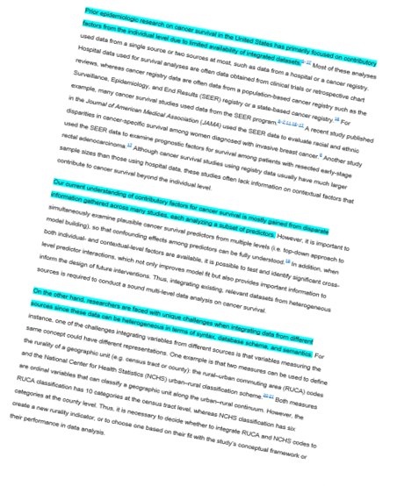

Checking your line of argument: Topic sentence outline
This is particularly useful for your introduction and conclusion
It is also useful for any larger sections of text within the main body of your project
Highlight the topic sentence (usually the first sentence). Read only the highlighted sentences- can you follow your argument?
Notes:
Jenny to introduce the day and run through the agenda

Slide 28
Checking your line of argument: Topic sentence outline example
See how the topic sentences (first sentences of each paragraph) show the logical progression of ideas:
Partial differential equations (PDEs) are used in myriad disciplines to model physical phenomena, including fluid dynamics, electromagnetism, and mathematical biology.
The advantage of FEniCS over other software is that it uses compiler technology to generate software where possible instead of just compiling and integrating hand-coded software libraries[30].
To demonstrate the use of FEniCS in solving real-world problems, we will examine PDE systems for several simplified glaciological models.
We now present a brief overview of glaciological models which are studied in Chapters 3–4.
Notes:
Jenny to introduce the day and run through the agenda

Slide 29
Review of session
The fishbone representation of a longer text
The main sections of the report
The importance of a clear line of argument
Planning effectively to achieve a coherent line of argument
Notes:
Jenny to introduce the day and run through the agenda

Slide 30
Resources:
https://www.phrasebank.manchester.ac.uk/
The Academic Phrasebank has academic language and expressions that help you to structure the different sections of your project.

